Slide 1
Lockerbie Manor 2022
Monday 28th March – Friday 1st April

Slide 2
Staff
Mrs Donnelly (Mon-Wed)– Group Leader
Mrs Allen (Wed-Fri)
Miss Deveney
Miss Ludford
Mrs MacIntyre
Ms Talbot (Mon – Wed)
Mrs Fyfe (Wed-Fri)

Slide 4
Activity Session Details
7am – Wake Up time
7.30am – Breakfast starts
9-10.30am – OUTDOOR ACTIVITY SESSION 1
10.30-10.50 – Break
10.50-12.20 – OUTDOOR ACTIVITY SESSION 2
12.20 – 13.40 – Lunch
13.40 – 15.10 - OUTDOOR ACTIVITY SESSION 3
15.10 – 15.30 – Break
15.30 – 17.00 - OUTDOOR ACTIVITY SESSION 4
17.15 – 19.00 – Dinner and Free time
19.15 – 20.45 - OUTDOOR ACTIVITY SESSION 5
21.30 – In Pods
22.00 - Bedtime

Slide 13
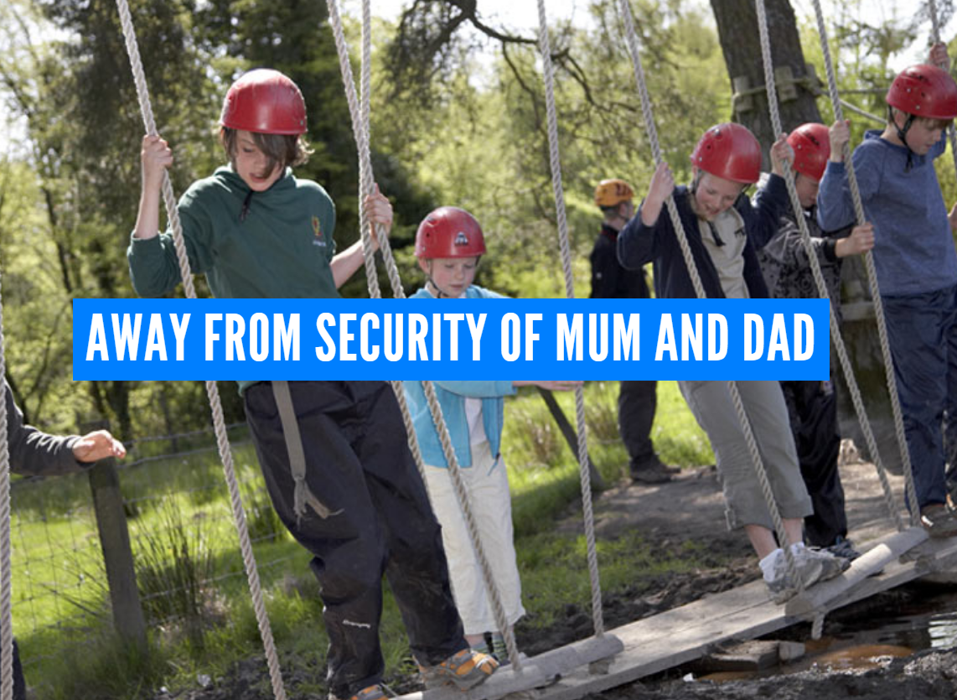

Slide 16
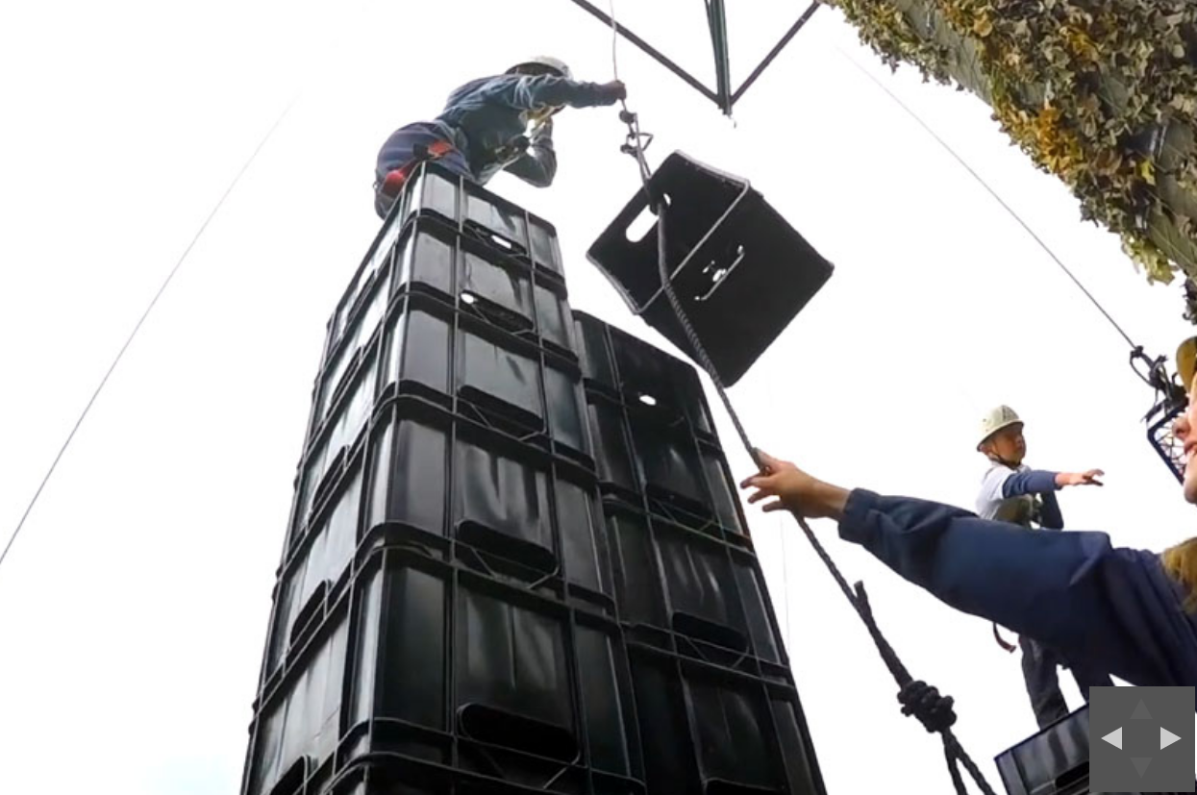

Slide 17
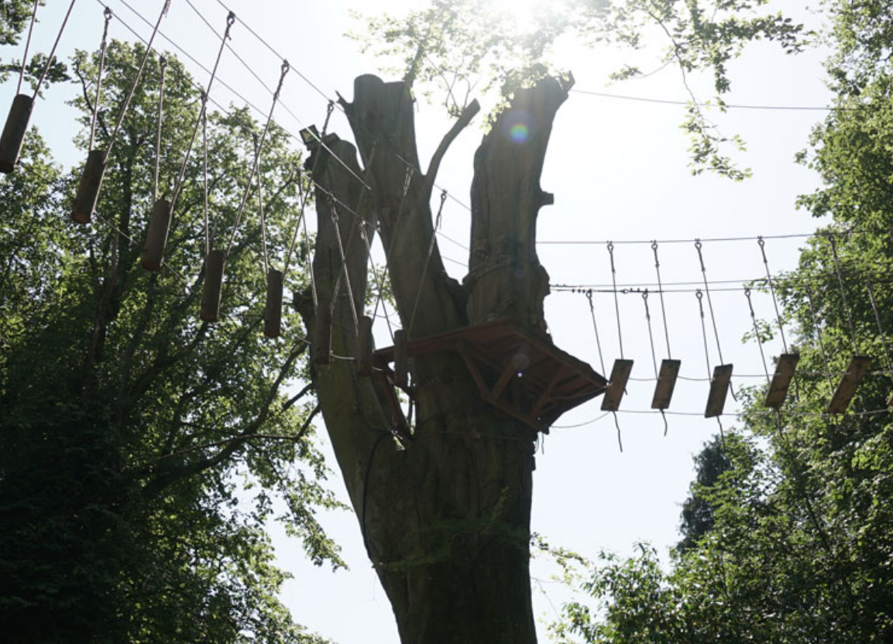

Slide 18
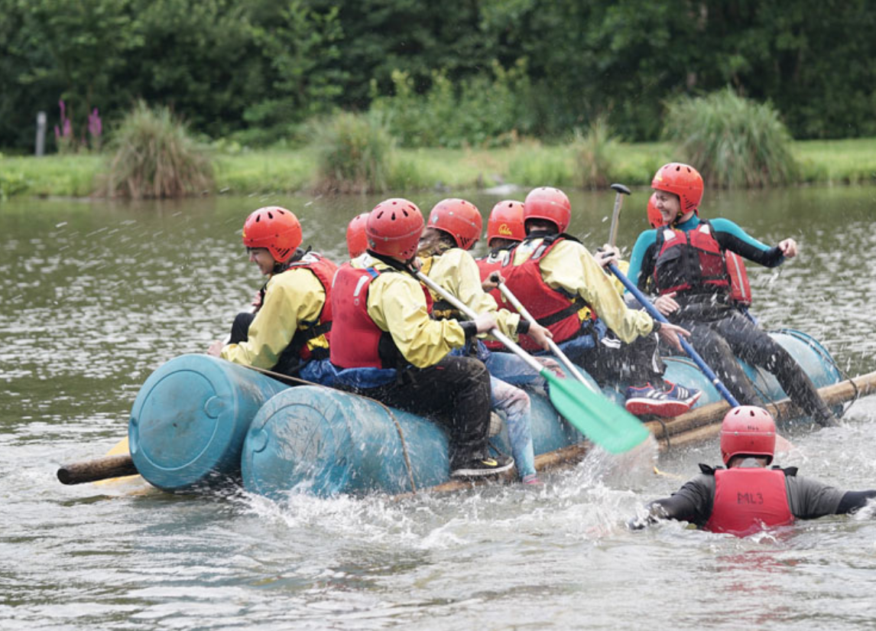

Slide 19
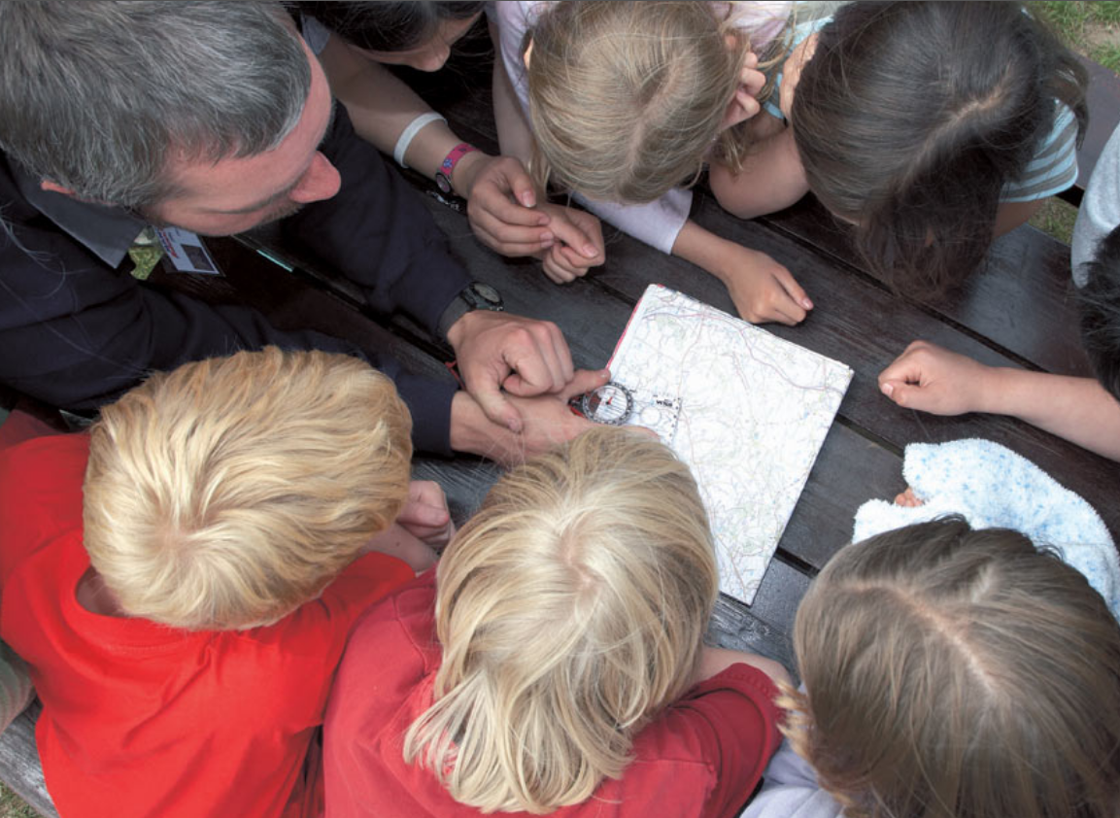

Slide 21
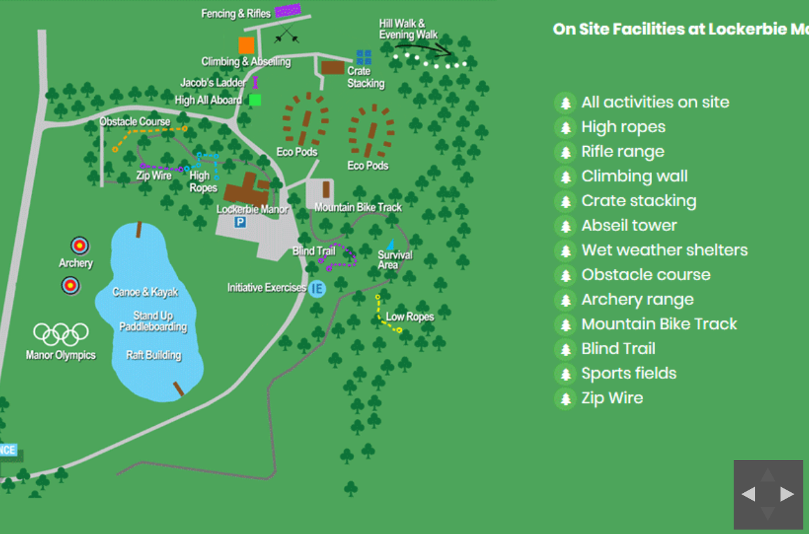

Slide 24
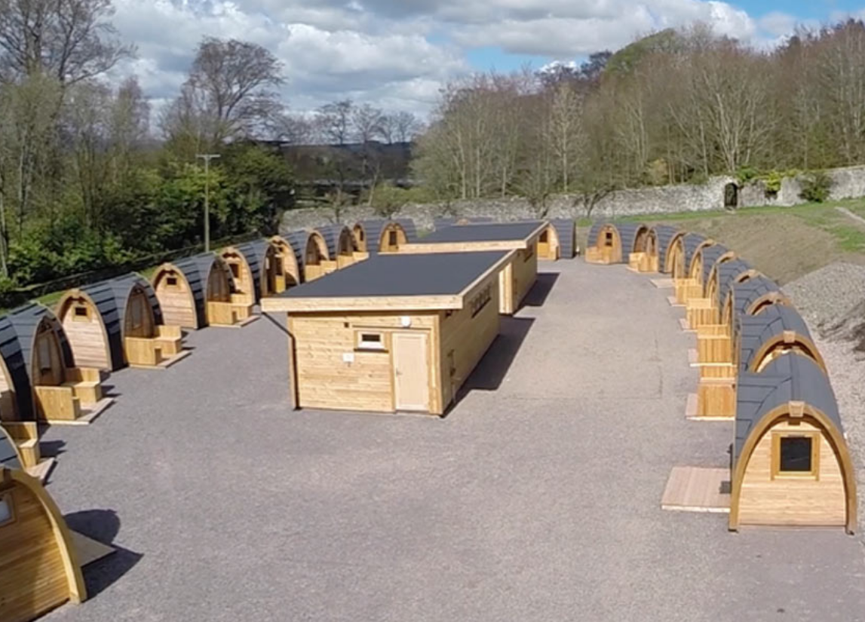

Slide 25
Kit List
Please try to limit luggage to one suitcase/hold all and one piece of hand luggage. Your child must be able to carry their own luggage.
It is essential that your child brings at least the stated amount. Lockerbie Manor has a strict ‘three layer’ policy, including at least one long sleeved layer, which applies to all activities, regardless of the weather. This is to ensure the safety and wellbeing of the children.
Pupils are advised on what to wear for each activity, however it is their responsibility to ensure they turn up at their activity on time with the correct clothing. No activity will start before all group members are properly attired.
Each Pod village has a drying room, so some clothes may be re-worn, even muddy ones!

Slide 26
General essentials
Sleeping bag
Pillow case and pillow
Drinks bottle
Rucksack
T Shirts / Long Sleeved Tops
Jumpers/Hoodies/Zip tops
Long Bottoms (not shorts or Jeans) at least – allocate one pair to get wet, and another to get muddy
Warm jacket x2 (may be worn under waterproof)
Waterproof jacket x 1 – waterproof trousers will be useful, but can be provided by Lockerbie Manor
Underwear
Socks
Toiletries in a wash bag
Bath Towels x2
Small torch
Several bin bags for laundry and muddy items i.e. shoes.

Slide 27
Shoes
1 pairs of shoes which are easy to put on to be used for walking from the pod to the toilet block.
1 pair of trainers/shoes that will be used for wet and muddy activities
A pair of sturdy shoes for other activities, these can include walking boots and/or trainers, NOT Wellies or snow boots.
Other essentials in March:
Hat
Gloves
Because we can’t predict the weather (if we are very lucky…)
Cap
Sun cream
Money
You may bring a maximum of £10 for tuck shop and souvenirs, however this is optional.
Useful notes:
No wellies allowed for activities.
All clothing and towels MUST be labelled clearly with the child’s name
Denim jeans are not allowed on any activity.
No jewellery (including piercings), except for stud earrings
No electronic devices, such as tablets or mobile phones, will be permitted on the trip
You may bring some quiet activities such as card games, books to read or a diary to write in

Slide 28
Photos
Teams – All photos will be posted by staff either when at Lockerbie or on our return. This will be heavily dependent on Wifi access.

Slide 29
Medicines
Illness before trip
Illness during trip
Medications

Slide 30
Any questions?
https://forms.office.com/Pages/ResponsePage.aspx?id=oyzTzM4Wj0KVQTctawUZKS_KoWATmS1Fq_uW6xVAMjJUN002U0s1R0VBQTdZOVhLVENSTDNTWE1WRy4u

